Slide 1
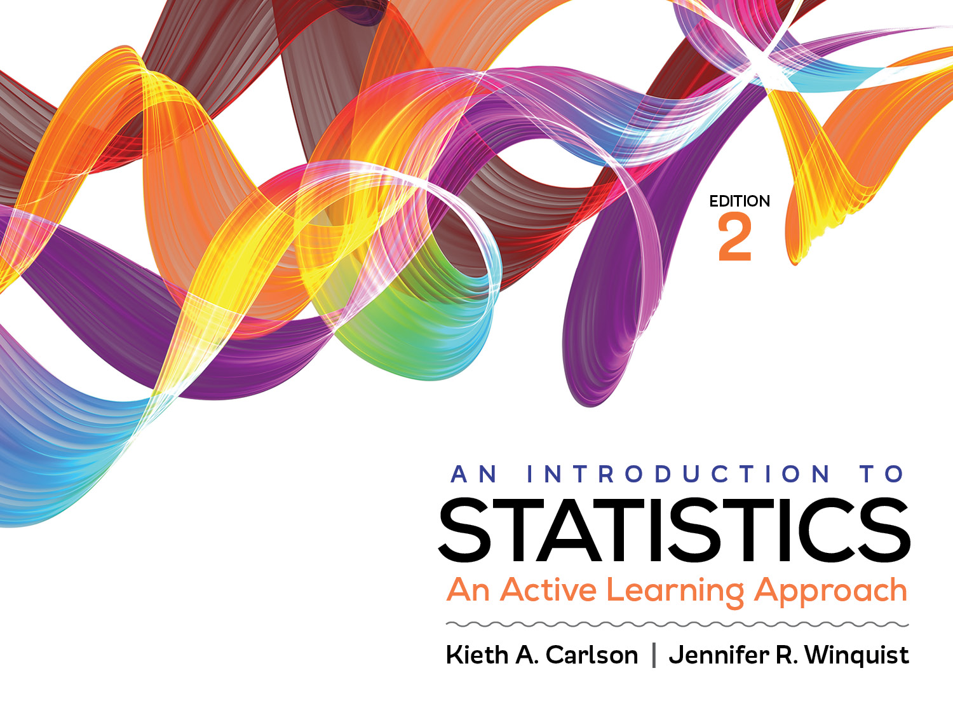
Introduction to Activity 11.2
Independent ANOVA with SPSS

Slide 2
Activity 11.2 will require you to:
Work through all 6 steps of an ANOVA hypothesis test using SPSS

Slide 3
Use the following if you need guidance
For annotated SPSS output go to pages 386–387.
For an example APA-style summary see question 40 in Activity 11.1

